Slide 1

First Intern task 1 Hotel Reservation
Team Member:
Omar Shehab
Osama Mohamed
Ilma Asif

Slide 2
Overview
Shape (36285, 17).
Binary Classification.
Number of booking (36285).

Slide 3
Preprocessing Steps
Exploration
Cleaning data
Feature extraction for Dates
Handel outlier
Encoding categorical to integer
Scaling

Slide 4
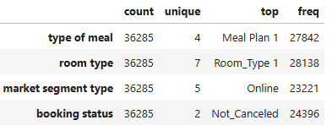
Exploration & Cleaning Data
Exploration
Number of categorical columns (6).
Number of Numrical colums (11).
Cleaning Data
Drop Booking_ID
No missing value
Categorical Columns

Slide 5

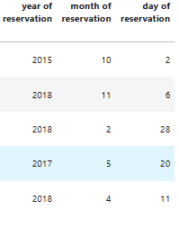
Feature extraction for Dates

Slide 6
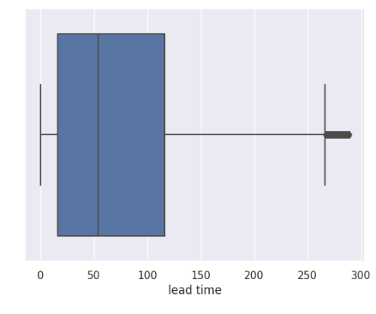
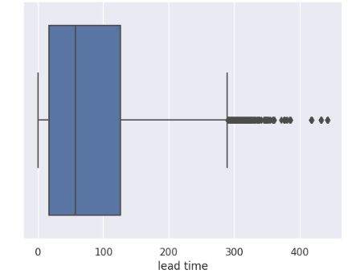
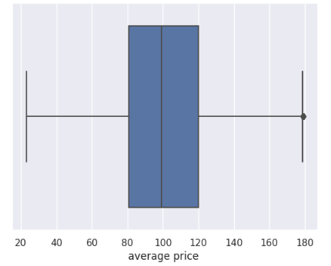
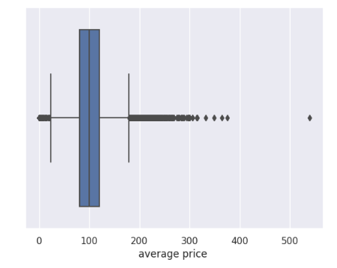
Handle Outlier
Using IQR

Slide 7
Encoding & Scaling
Encoding
Using Label encoder to encode categorical to numerical.
(Room type, Type of meal, market segment type and booking status)
Scaling
Using Robust scaler after splitting Data.

Slide 8
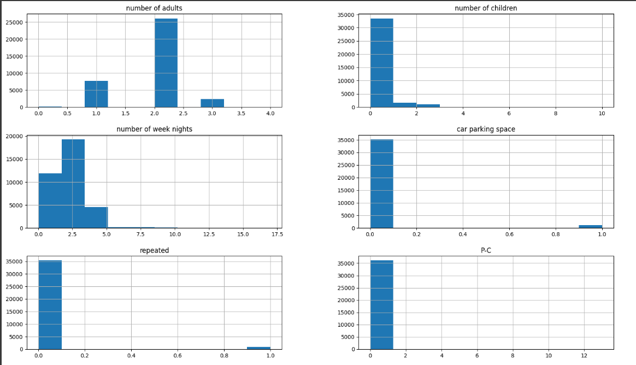
Data Visualization
We used histograms to understand how different numerical values are spread out

Slide 9
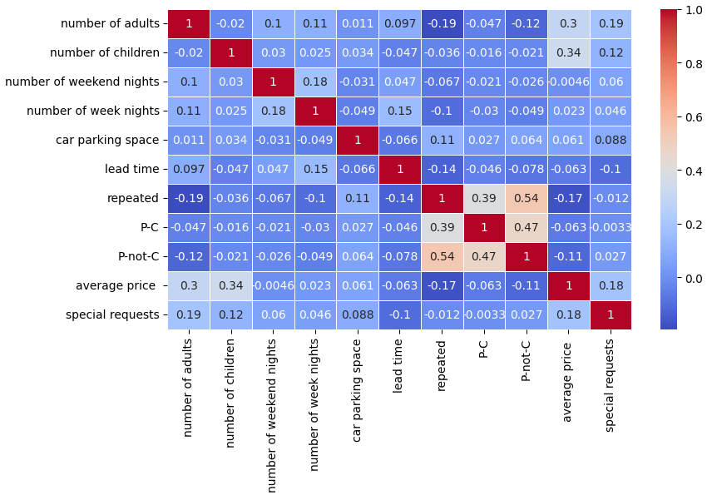
Correlation Matrix- What relationships exist between numbers?

Slide 10

Questions

Slide 11


